Slide 1
Dysregulation: Emotional & behavioral
What Can You Do: Assessments, Strategies, Behavioral Plans

Slide 2
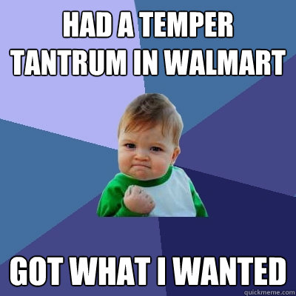
What is behavioral & emotional dysregulation?
Level 1:
Odd noises;
Obstinate
Refusing to follow directions
Bothering others
Difficulty calming down
Level 2:
Defiance
Temper Tantrums
Purposeful negative behaviors
Starting fights
Violating rules
Level 3:
Hurting self or others
Property Destruction
Running Away

Slide 3
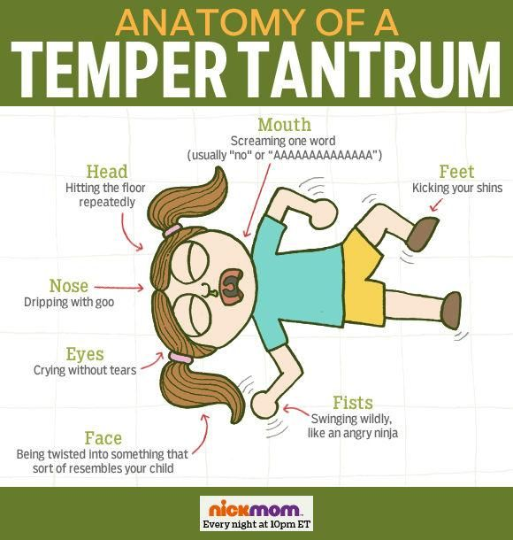

Slide 4
What is behavioral & emotional dysregulation
Assessments allow you to identify the target behavior, i.e. what are you going to work on first?
FBA allows you to collect data from observations and collaborative data from parents, previous teachers, etc.
Data will assist you in identifying the intensity, frequency and duration of the target behavior.
Leads you to the identification of the function of the behavior(s):
Skill deficit: a skill the child does not know how to do, i.e. “can’t”
Performance deficit: child knows the skill however doesn’t do it consistently, i.e. “won’t”
Pain: emotional or physical pain
Sensory deficits: i.e. hearing levels need adjustment; visual adjustments, certain smells; foods
Attention: any attention is better than no attention
Control: over one’s environment, power over emotions, power over decisions
Escape: because the child is confused, what he is doing is too hard=incompetence, to get attention, doesn’t want to be there
Assessments:
Now that we are aware of the different levels of behaviors, how do we know what and how to address?
Assessment is a good place to start, you want to do some direct observations, intake form/problem checklist with parents, Functional Behavior Assessment (FBA), Reinforcer Inventories, to name a few.

Slide 5
What is behavioral & emotional dysregulation?
Strategies:
Distraction:
Premade errands to send the child or tasks to do to assist in diffusing the escalation
Use of Schedule:
Be flexible to re-do schedule, i.e. finishes assignment, allow break time, use of fidgets
Premack Principle:
First, Then
See Slide
Out of Classroom Conversation:
Have a teacher/staff walk out of class with child to assist in de-escalation to identify a plan, i.e. remind him of his break card he can use
My Turn/Your Turn:
Create a badge stating “my turn” on one side and “your turn on the other side
Special Word:
Teacher & student can a special word/cue to initiate a break, i.e. “it’s cloudy”
Use of a break card:
Teacher/student can initiate break card
Designate place for break
Intervention Activities:
Identify the preferred activities from inventory
Set up small rewards that relate to the preference
Identify behaviors to earn rewards
Set a time period of when the reinforcers will be given and how to earn the GRAND PRIZE:
Trip to the movies/DVD for class/Comic Book
Phone call to parents
Listen to Music
Earn time to play with their games, i.e. UNO
Beauty Time
Early Out
Behavioral plans:
From these inventories you can identify the following:
Token Systems
Tangibles/objects
Also can be edibles
Activity reinforcer
Preferred activity
Sensory reinforcers
Water, smells, music, rocking
Create sensory boxes

Slide 7
What is behavioral & emotional dysregulation?
Calming Activities:
Go for a walk
Do a chore
Listen to calm music
Speak with a staff who is not involved with crisis
Take deep breaths
Drink a glass of water
Systematic relaxation
Guided Imagery
Child’s Quiet Time:
Initiate before the child has escalated
“You seem like you’re not feeling well or upset”
Offer quiet space and non-aggressive activity
Let them stay in quiet time as long as they like
Upon return: “it’s good you were able to do that”
Offer “you can do this again if you need it, it is okay to ask for quiet time?
Develop a plan to return to the area/activity

Slide 8
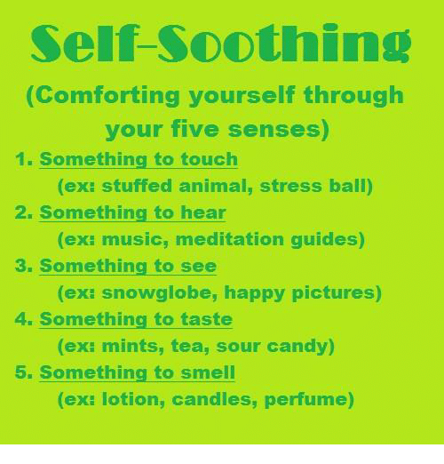
What is behavioral & emotional dysregulation?
References:
Scott Walls and Deb Rausner. (2015) Behavior Management Skills Guide. PESI Publishing
Jennifer Wilke-Deaton. (2014) Parenting Better Children: An 8 Week Skills Training Guide. PESI Publishing

